Slide 1


Magento Mobile Shop
IGATE is now a part of Capgemini

Slide 2
TEAM MEMBERS
Group: 2
Alok Nanda
Anwesha Basu
Ashish Choudhary
Ayush Srivastava
Badal Ahuja

Slide 3

Application link
https://www.magentomobileshop.com

Slide 4
OVERVIEW OF THE PROJECT
Magento Mobile Shop is an upcoming native app builder brand that aims at revolutionizing the ecommerce businesses around the globe.
With its free Magento mobile app extension, anybody can easily create fully native applications with rich functionality.

Slide 5
Actors
User/Customer
Admin

Slide 6
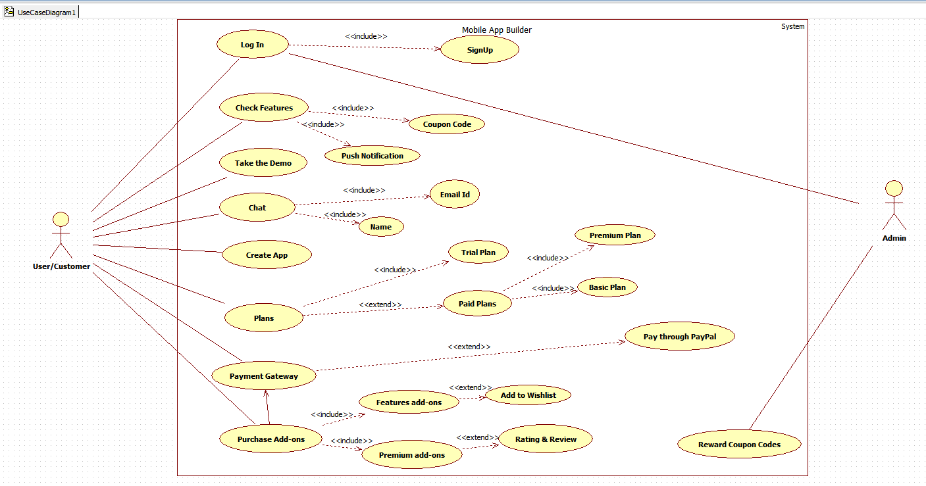
Use Case Diagram

Slide 7
TEST CASES

Slide 8
DEFECT REPORT

Slide 9
Test Case Adequacy :
Test Case Adequacy = No. Of actual test cases * 100 / No. of test cases estimated.
In our case:
No. of actual test cases = 39
No. of test cases estimated = 45
Test Case Adequacy = 86.66%

Slide 10
Test Case Effectiveness:
Test case Effectiveness = (No. of defects detected using test cases * 100) / (Total No. of defects detected in testing)
No. of defects detected using test cases = 13
Total No. of defects detected in testing = 20
Test case Effectiveness = 65%

Slide 11
Tracebelity Matrix
Business Requirements ID | Business Requirements Description
B001 | The URL should be visible in every page of the Website.
B002 | Only a registered user can access the website.
B003 | The password field should accept one special character ,uppercase and lower case and no blank spaces.
B004 | Only the registered user has an accessibility to make payments in payment gateways.
B005 | LogIn button sould be present in every page of the website
B006 | Only valid username should be accepted having alphabets.
Requirements | B001 | B002 | B003 | B004 | B005 | B006
TC_S_001 | Y | Y | Y | N | Y | Y
TC_S_002 | Y | Y | Y | N | Y | Y
TC_S_003 | Y | N | Y | N | Y | N
TC_S_004 | Y | N | N | N | Y | Y
TC_S_005 | Y | N | Y | N | Y | N
TC_S_006 | Y | Y | N | N | Y | Y
TC_S_007 | Y | Y | Y | N | Y | N
TC_S_008 | Y | N | N | N | Y | Y
TC_IS_001 | Y | Y | N | N | Y | N
TC_IS_002 | Y | N | N | N | Y | N
TC_IS_003 | Y | N | N | N | Y | N
TC_IS_004 | Y | N | N | N | Y | N
TC_IS_005 | Y | N | N | N | Y | N
TC_IS_006 | Y | N | N | N | Y | N
TC_IS_007 | Y | Y | Y | Y | Y | Y
Requirements | B001 | B002 | B003 | B004 | B005 | B006
TestCaseId
TC_UC_001 | Y | N | N | N | Y | N
TC_UC_002 | Y | N | N | N | Y | N
TC_UC_003 | Y | N | N | N | Y | N
TC_UC_004 | Y | Y | N | N | Y | N
TC_UC_005 | Y | Y | Y | N | Y | Y
TC_UC_006 | Y | Y | Y | N | Y | Y
TC_ST_001 | Y | Y | N | N | Y | N
TC_ST_002 | Y | Y | Y | N | Y | Y
TC_ST_003 | Y | N | Y | N | Y | Y
TC_ST_004 | Y | Y | N | N | Y | N
TC_ST_005 | Y | Y | N | N | Y | N
TC_ST_006 | Y | Y | N | N | Y | N
TC_ST_007 | Y | N | N | N | Y | N
TC_ST_008 | Y | N | N | N | Y | N
TC_ST_009 | Y | N | N | N | Y | N
TC_CE_001 | Y | N | N | N | Y | N
TC_CE_002 | Y | N | N | N | Y | Y
TC_CE_003 | Y | N | N | N | Y | Y
TC_CE_004 | Y | N | N | N | Y | Y
TC_CE_005 | Y | N | N | N | Y | Y
TC_CE_006 | Y | Y | Y | N | Y | Y
TC_CE_007 | Y | Y | Y | N | Y | Y
TC_CE_008 | Y | Y | Y | N | Y | Y
TC_CE_009 | Y | Y | Y | N | Y | Y

Slide 12

Any Queries?

Slide 13
Thank You

